Slide 1
Grading Authentic Assessment Using Canvas Rubrics, an iPad and the SpeedGrader App
Kelley L. Meeusen and Cindy Overton
Clover Park Technical College

Slide 2
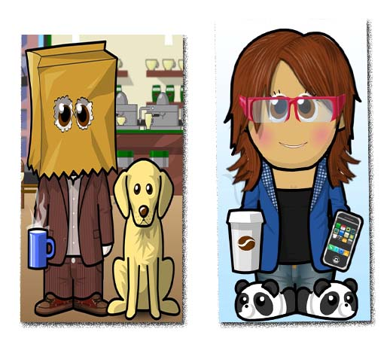
About Us
Who we are
Kelley / Cindy
Notes:
Examples:
Grading the student’s preparation of a specimen slide in our histology program
Grading student’s practicing venipuncture on each other in our nursing program – and isn’t that something we all want to volunteer for
Grading the coloring of a victim’s – oops, I meant “volunteer’s” – hair in our cosmetology program
To grade an oral exam so that it is accessible to a disabled student.
Grading a student’s performance of a patient assessment during their hospital clinical practicum.

Slide 3
About the College

Slide 4
Agenda
What is Authentic Assessment
The Process
The Steps
Questions?

Slide 5
What is Authentic Assessment
"...Engaging and worthy problems or questions of importance, in which students must use knowledge to fashion performances effectively and creatively. The tasks are either replicas of or analogous to the kinds of problems faced by adult citizens and consumers or professionals in the field." -- Grant Wiggins -- (Wiggins, 1993, p. 229).
Okay, okay, Grant, we get it – our students do something, we watch them do it, we grade what we see.

Slide 6
Types of Authentic Assessments
Observational Assessments
Formative
Summative
Oral Assessments
Internships
Externships
Clinical Practicum Assessments

Slide 7
Authentic Assessment
An authentic assessment usually includes a task for students to perform and a rubric by which their performance on the task will be evaluated.
In the traditional classroom, the rubric is most often a checklist of some kind

Slide 8
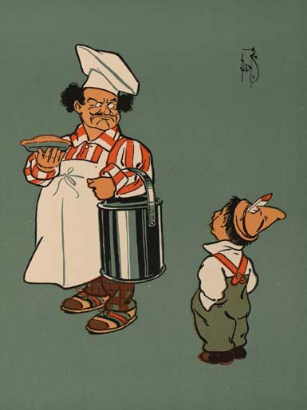
A Stupidly Simple Process

Slide 9
But also very powerful in its application!

Slide 10
Examples
Conducting a band
Performing an exercise routine
Performing a sport
Musical performance – voice or instrument
Interviewing
Speaking a foreign language
Performing sign language
Performing a patient assessment

Slide 11
More examples
Prepping a car for a restorative paint job
Performing a pedicure
Practicing veni-puncture on classmates – eew!
An oral presentation in front of peers and colleagues
Oral Exams
Visually impaired
Learning disabilities
ESL/ABE students
The only limit is our imagination

Slide 12
Advantages of Technique
Quicker and easier for the instructor!
Create once/use forever
No spreadsheets
No hand-calculations
No confusing Excel spreadsheet formulas
Green
Immediate feedback to the student
Automatic grade calculation and display

Slide 13
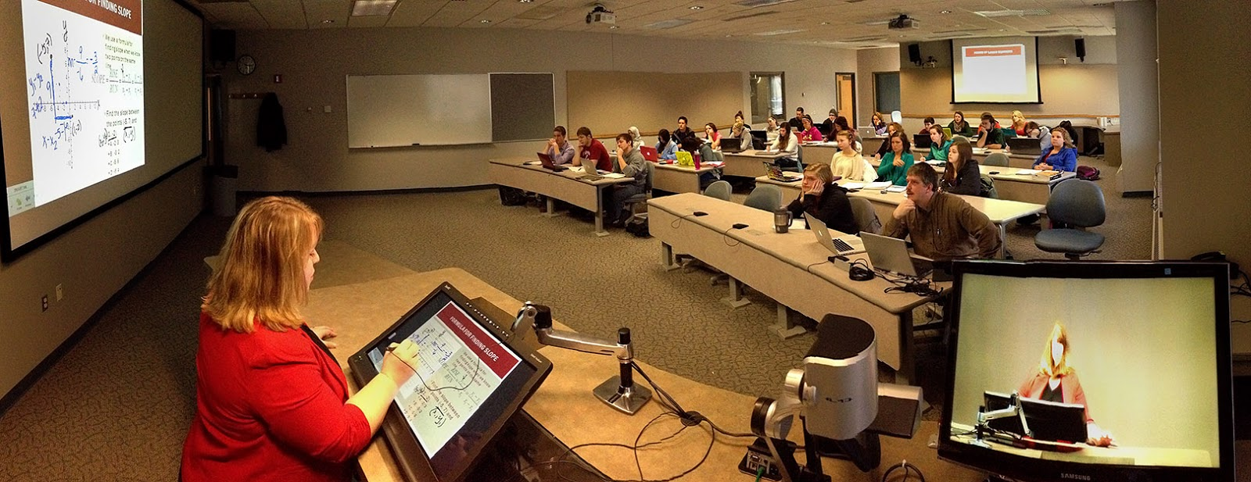
Any Instructional Delivery format
Traditional
Web-enhanced
Hybrid/Flipped
Even fully online

Slide 14
Process
Convert a manual checklist or paper rubric to a Canvas grading rubric attached to a Canvas Assignment, and use the SpeedGrader App on an iPad (or Android) to record grades while observing student performance
Easy as pie, and way easier than pecan pie!

Slide 15
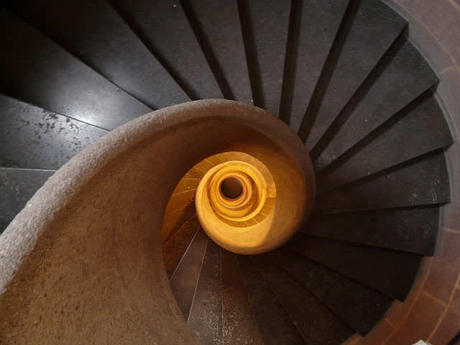
Steps
Create the Canvas Assignment
Create the Canvas grading rubric for the assignment (just copy your criteria and ratings into the Canvas grading rubric)
Set up the assessment situation
Open the SpeedGrader App, and navigate to the assignment
Select the student
Grade using the Rubric

Slide 16
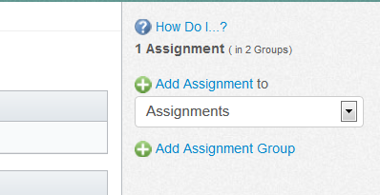
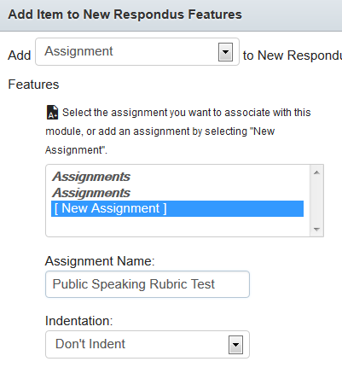
Create the Assignment
Create in Assignments
Or create in a module

Slide 17
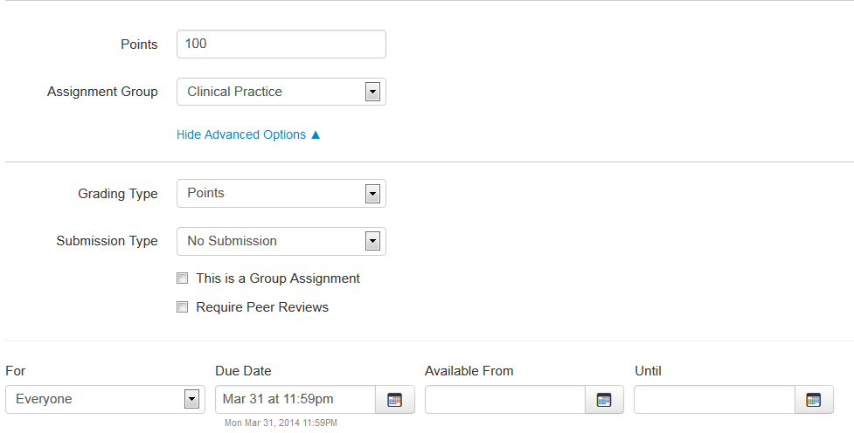
Assignment Settings
Open the assignment, click Edit, and
In Advanced Options, set submission type to “No Submission”
No Submission

Slide 18
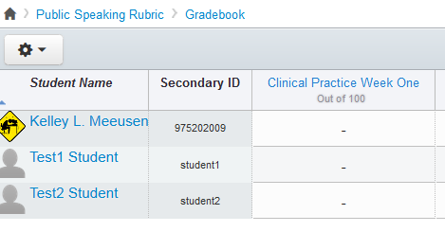
Assignment Creation
Grade Book place-holder is created, and Speedgrader can then be used to enter student grades

Slide 19
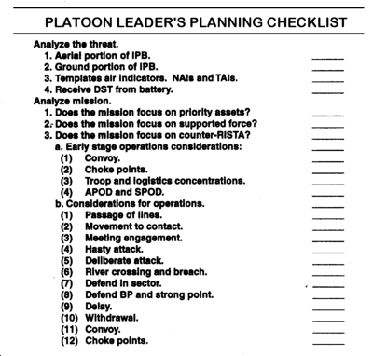
Create the Grading Rubric
You can develop your rubric from an existing observation checklist,
Or create one from scratch

Slide 20
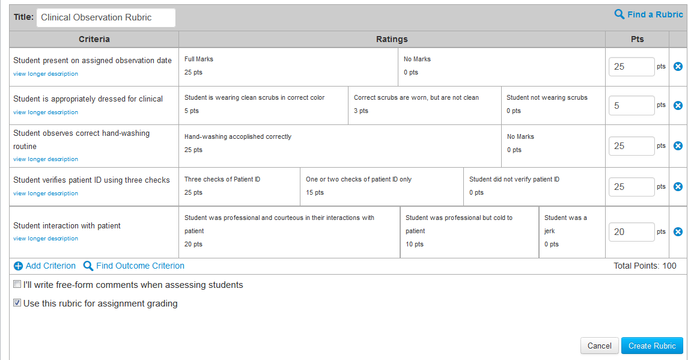
Develop Canvas Grading Rubric
Navigate to Assignment, and click
In the rubric setting, select “Use this rubric for assignment grading”

Slide 21
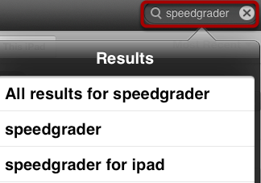
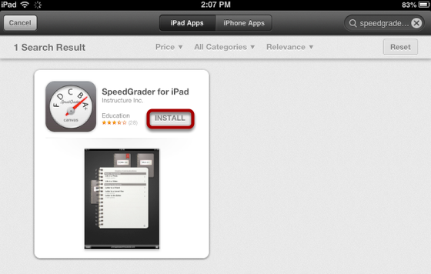
Locate and Load SpeedGrader App on iPad
Open App Store
Search for App
Open App and click Install

Slide 22
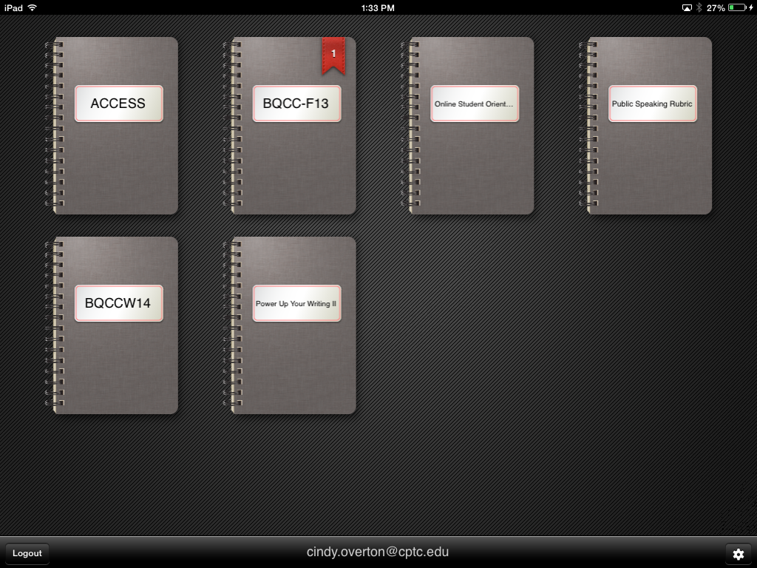
Using the SpeedGrader App
Open SpeedGrader App on the iPad, and tap the Course Notebook icon that contains the assignments you wish to grade.

Slide 23
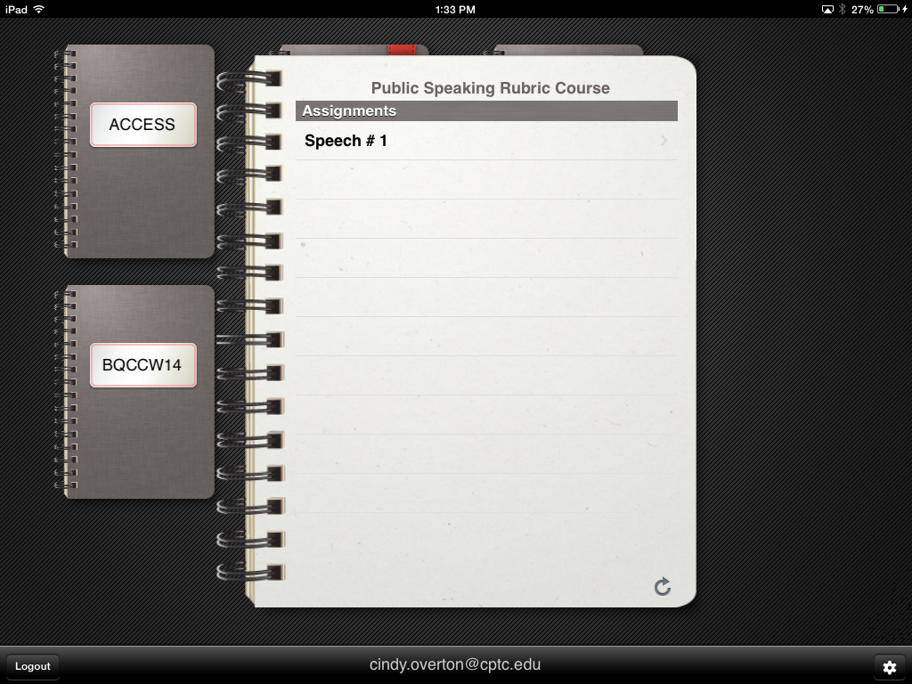
Using the SpeedGrader App
Choose Assignment,
Tap to open

Slide 24
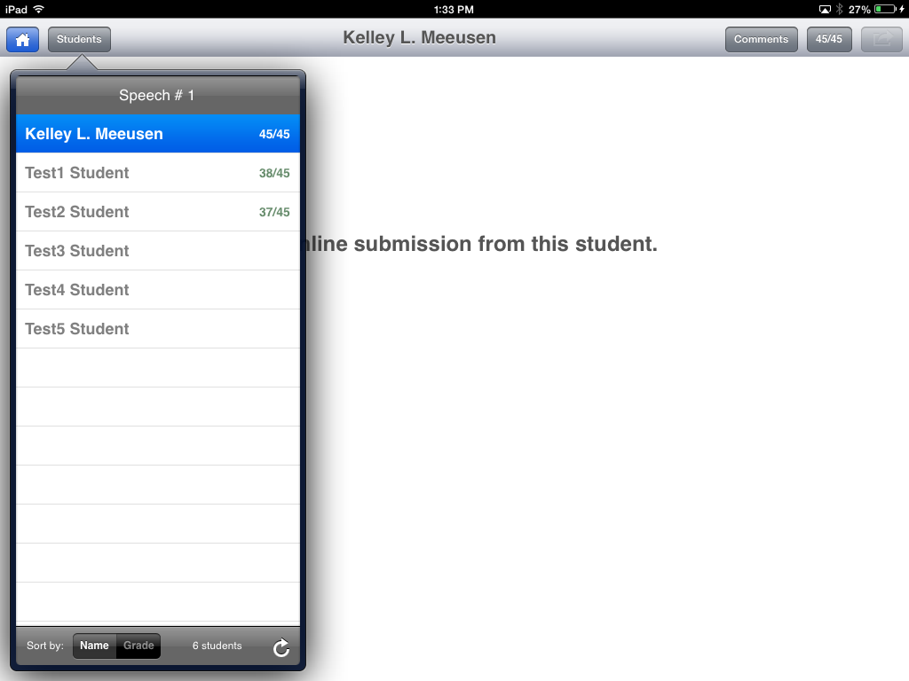
Using the SpeedGrader App
Select Student

Slide 25
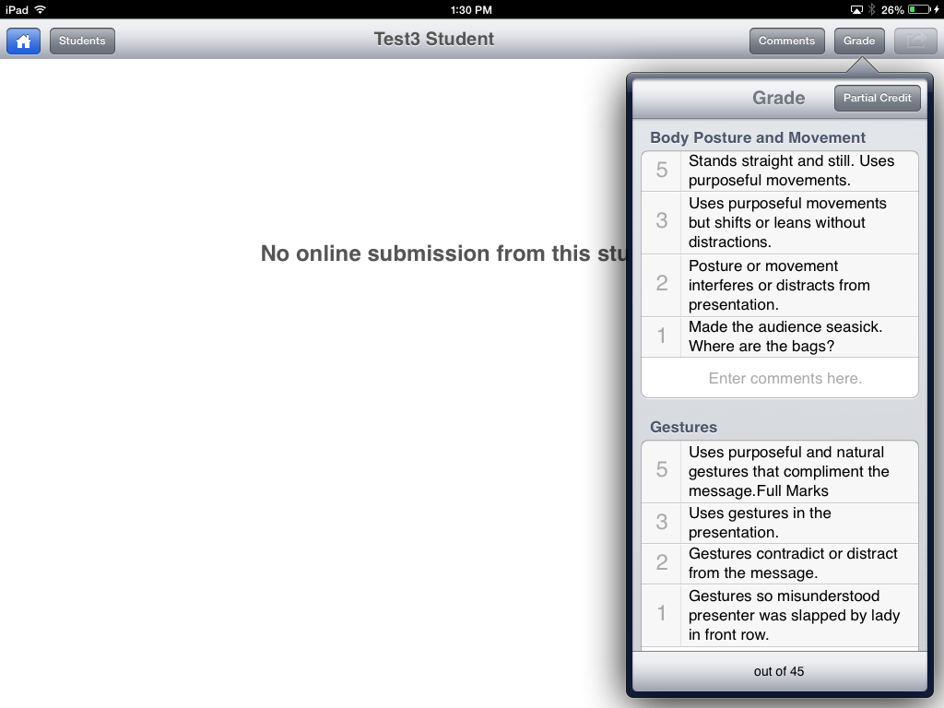
Using the SpeedGrader App
Tap “Grade”, and the grading Rubric will open,
Tap ratings to enter scores,
Tap “Save” to save scores to Canvas Grade Book.

Slide 26
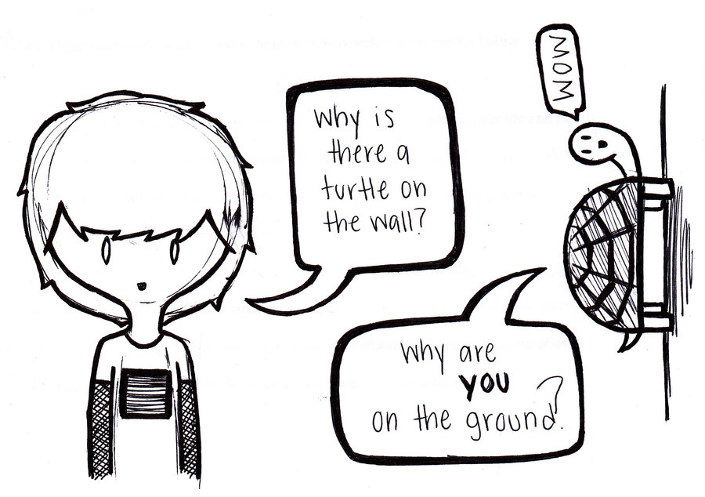
Questions?

